Slide 1
Water Potability Prediction
By : Akshat Khanna

Slide 2
Agenda
Water Potability Analysis
A Comprehensive Study Using Machine Learning
Akshat Khanna
01-02-2025

Slide 3

Introduction
Brief Introduction to Water Potability:
Water potability refers to the suitability of water for human consumption. It is crucial for public health, as contaminated water can lead to serious health issues, including waterborne diseases.
Ensuring that water is safe to drink is a significant concern for governments and health organizations worldwide.
Importance of the Study:
With increasing pollution and environmental changes, monitoring water quality has become more critical than ever.
This study aims to analyze water quality data to determine the potability of water samples using machine learning techniques.
Objective of the Project:
The primary objective is to develop predictive models that can classify water samples as potable (safe for drinking) or non-potable (unsafe for drinking).
By identifying key features that influence water quality, the study seeks to provide insights that can help in water quality management and policy-making.

Slide 4
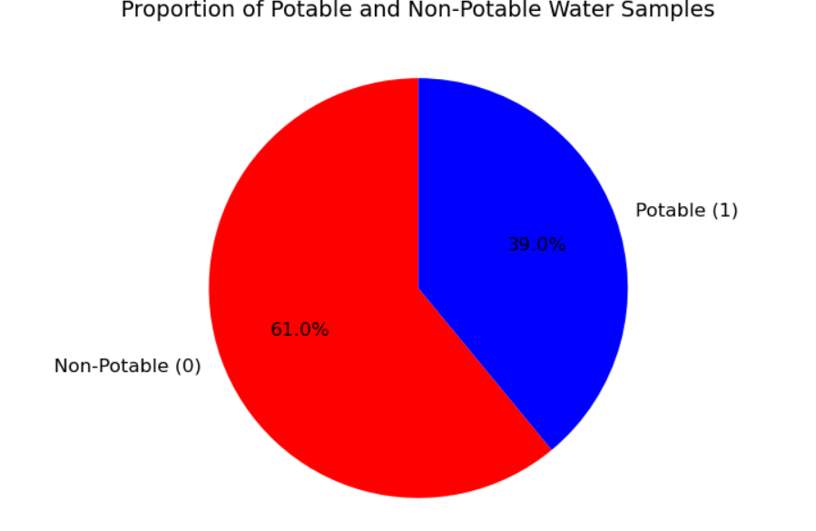
Dataset Overview Content:
Description of the Dataset:
The dataset used for this analysis is titled "water_potability.csv."
It contains 3,276 samples of water quality measurements, each with 8 features plus the target variable, which indicates whether the water is potable (safe for drinking) or non-potable (unsafe for drinking).
Features:
The dataset includes the following features:
pH: A measure of acidity or alkalinity of the water.
Sulfate: Concentration of sulfate ions in the water.
Trihalomethanes: A group of chemical compounds that can form when chlorine is used to disinfect water.
Conductivity: A measure of the water's ability to conduct electricity, which correlates with the concentration of dissolved salts.
Turbidity: A measure of the cloudiness or haziness of the water, indicating the presence of suspended particles.
Solids: Total dissolved solids in the water.
Chloramines: A disinfectant used in water treatment.
Organic Carbon: A measure of organic compounds in the water.
Target Variable:
The target variable is "Potability," which is an integer (0 or 1):
0: Non-potable (unsafe for drinking)
1: Potable (safe for drinking)

Slide 5
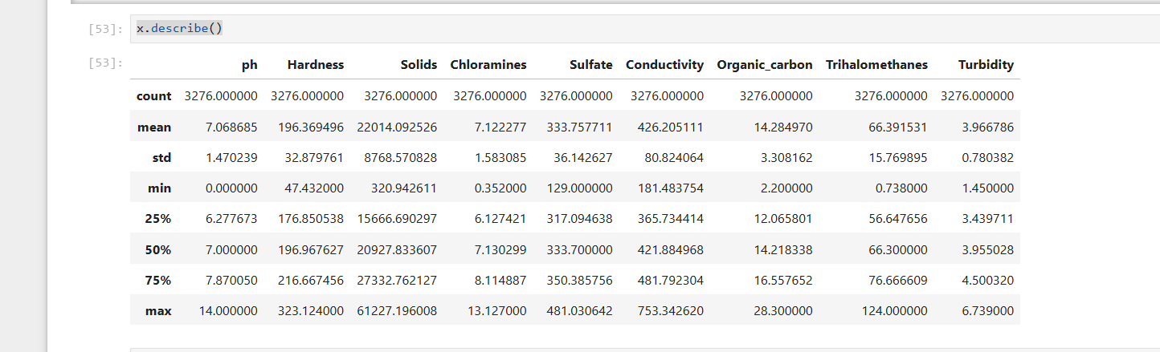
Data Exploration
Summary of the Dataset:
The initial exploration of the dataset provides insights into its structure and the nature of the data.
Using methods like df.info() and df.describe(), we can gather essential information about the dataset, including the number of samples, data types, and basic statistics for each feature.
Key Observations:
The dataset consists of 3,276 samples and 9 columns (8 features + 1 target variable).
All features are numerical, with 8 being floats and 1 being an integer (the target variable).
The describe() function reveals statistical measures such as mean, standard deviation, minimum, and maximum values for each feature, which helps in understanding the distribution and range of the data.
Missing Values:
An important aspect of data exploration is identifying missing values. The dataset contains missing values in the following features:
pH: 491 missing values
Sulfate: 781 missing values
Trihalomethanes: 162 missing values
Understanding the extent of missing data is crucial for deciding on appropriate data cleaning and imputation strategies.

Slide 6
Water Quality Parameters
Key Parameters for Potability:
This slide outlines the critical physical, chemical, and microbiological parameters that determine water potability, such as pH, turbidity, total dissolved solids (TDS), and the presence of harmful microorganisms.
Health Implications:
Each parameter is linked to potential health risks, emphasizing the importance of maintaining safe levels to prevent waterborne diseases.
Regulatory Standards:
The slide may also reference established guidelines or standards set by health organizations for acceptable levels of these parameters in drinking water.

Slide 7
Key Parameters for Potability:
This slide highlights essential physical, chemical, and microbiological parameters that are crucial for assessing water potability. Key parameters include:
pH: Indicates the acidity or alkalinity of water.
Turbidity: Measures the cloudiness or haziness caused by large numbers of individual particles.
Total Dissolved Solids (TDS): Represents the combined content of all inorganic and organic substances in water.
Microbial Contaminants: Presence of harmful microorganisms such as bacteria, viruses, and protozoa.
Health Implications:
Each parameter is associated with specific health risks. For instance:
High turbidity can harbor pathogens, increasing the risk of waterborne diseases.
Deviations in pH can affect the solubility of metals and other contaminants, posing health hazards.
Regulatory Standards:
The slide references guidelines from health organizations, such as the World Health Organization (WHO) or the Environmental Protection Agency (EPA), which set acceptable limits for these parameters in drinking water to ensure public safety.

Slide 8
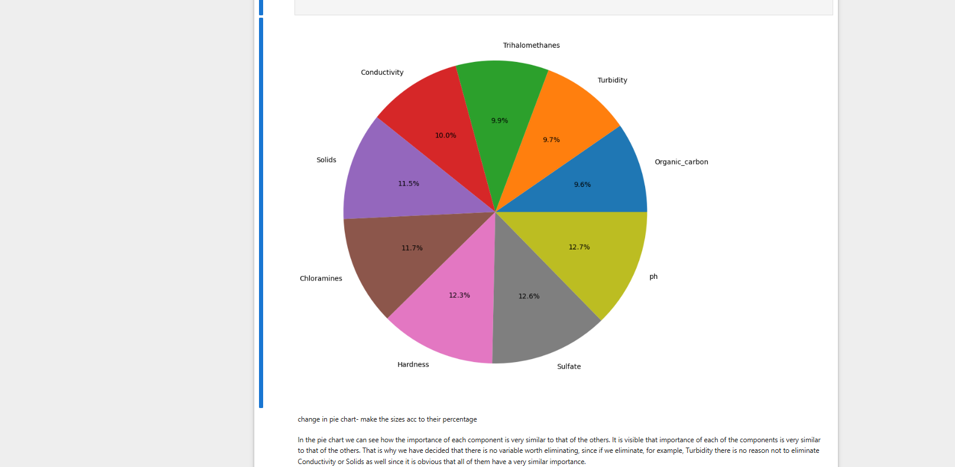

Slide 9
Data Cleaning
Identifying Missing Values:
The initial exploration revealed that certain features in the dataset contained missing values:
pH: 491 missing values
Sulfate: 781 missing values
Trihalomethanes: 162 missing values
Missing values can lead to biased results and affect the performance of machine learning models, making it essential to address them.
Handling Missing Values:
To clean the dataset, missing values were replaced with the mean of their respective features. This method is chosen because:
It maintains the overall distribution of the data.
It is a simple and effective way to handle missing data without introducing significant bias.
After imputation, a check was performed to confirm that no missing values remained in the dataset.
Final Dataset Overview:
After cleaning, the dataset is now complete and ready for further analysis and modeling.
This step ensures that the data is reliable and suitable for training machine learning models.

Slide 10
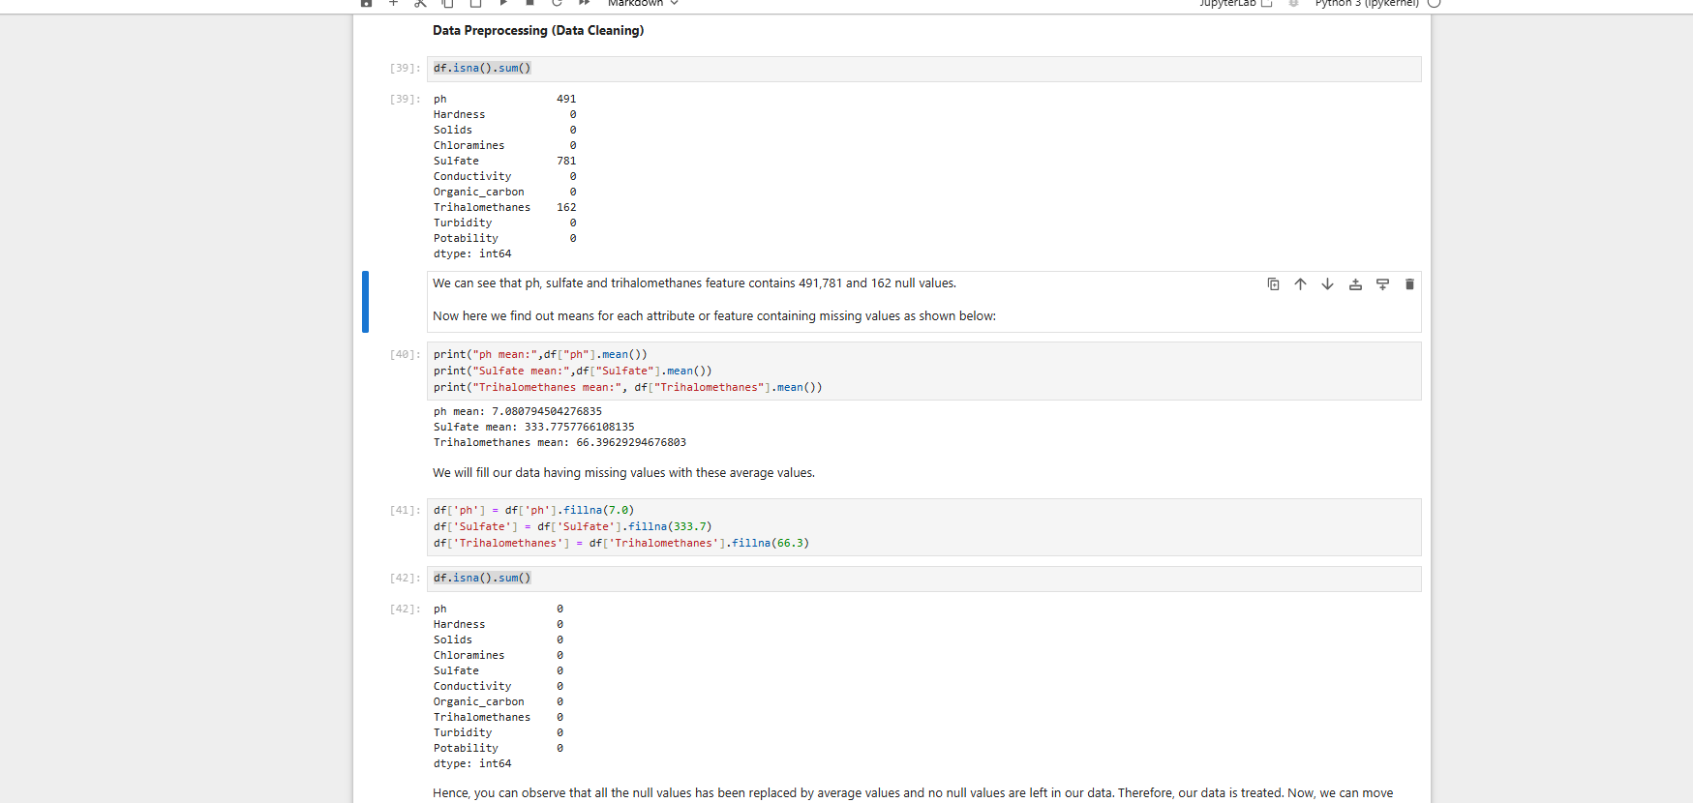

Slide 11
Correlation Heatmap
Understanding Correlation:
Correlation measures the strength and direction of the relationship between two variables. In the context of this dataset, it helps us understand how different features relate to each other and to the target variable (Potability).
A correlation coefficient close to +1 indicates a strong positive correlation, while a coefficient close to -1 indicates a strong negative correlation. A coefficient around 0 suggests no correlation.
Heatmap Visualization:
A heatmap is used to visually represent the correlation matrix, where:
Each cell in the heatmap shows the correlation coefficient between two features.
The color intensity indicates the strength of the correlation (e.g., dark colors for strong correlations and lighter colors for weak correlations).
The heatmap allows for quick identification of which features are positively or negatively correlated with the target variable (Potability).
Key Insights:
Highlight any significant correlations observed in the heatmap:
For example, if the pH level shows a strong positive correlation with potability, it suggests that as pH increases, the likelihood of water being potable also increases.
Conversely, if turbidity shows a negative correlation, it indicates that higher turbidity levels are associated with non-potable water.

Slide 12
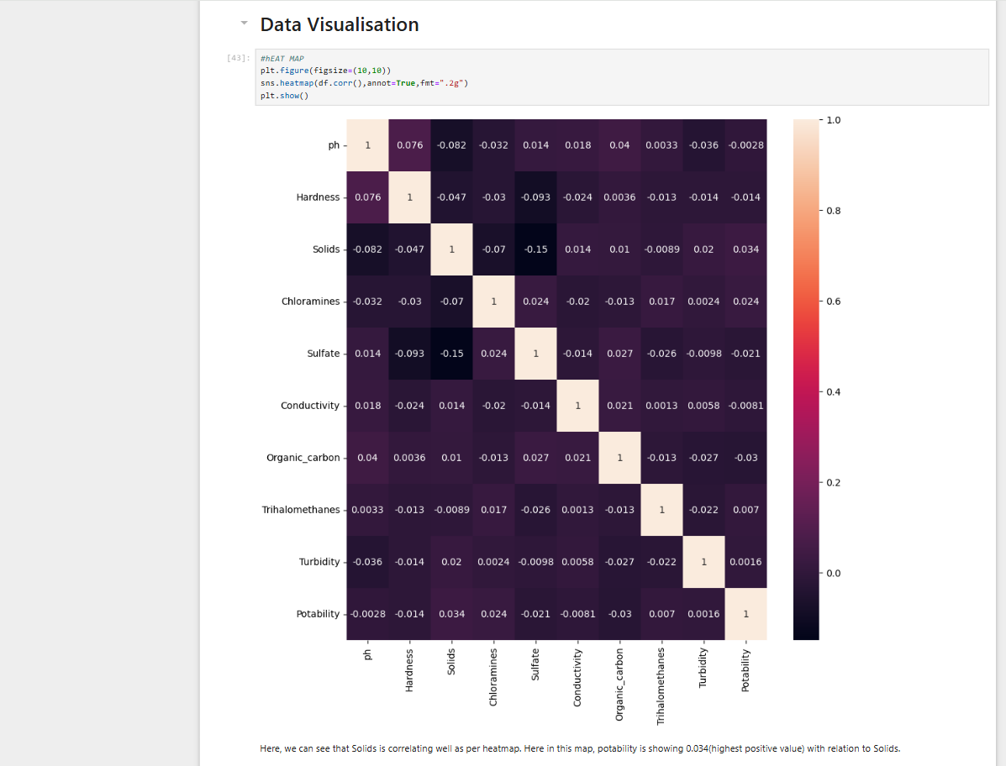

Slide 13
Positive Correlation (Closer to +1.00, shown in blue shades):
A high positive correlation (e.g., 0.85) means that as one feature increases, the other also increases.
Example: If Hardness and Solids have a strong positive correlation (~0.7 - 0.9), it means higher Hardness levels often come with higher Solids concentration.
Negative Correlation (Closer to -1.00, shown in red shades):
A high negative correlation (e.g., -0.75) means that as one feature increases, the other decreases.
Example: If pH and Turbidity show a negative correlation, it suggests that higher pH levels lead to lower turbidity.
Weak or No Correlation (Closer to 0.00, lighter shades):
A correlation near 0.00 means there is little to no relationship between the two variables.
Example: If Chloramines and Sulfate have a correlation close to 0, it means changes in Chloramines levels do not affect Sulfate levels.
"The heatmap provides a visual representation of feature relationships in our dataset. Strong correlations (both positive and negative) help us understand dependencies among water quality parameters. For instance, we observe a strong correlation between Hardness and Solids, which means water with high Hardness tends to have a high Solids concentration. Similarly, weak correlations indicate that some parameters may not significantly impact water potability. These insights guided our feature selection process, ensuring that only the most relevant parameters were used for model training."

Slide 14
Water Quality Parameters
Key Parameters:
This slide outlines the essential physical, chemical, and microbiological parameters that determine water potability, such as pH, turbidity, dissolved oxygen, and the presence of contaminants.
Importance of Monitoring:
Regular monitoring of these parameters is crucial for ensuring safe drinking water and protecting public health.
Regulatory Standards:
It may also reference specific regulatory standards that define acceptable levels for these parameters to classify water as potable.

Slide 15
Content:
Key Parameters:
This slide highlights critical physical, chemical, and microbiological parameters that influence water potability, including:
pH: Indicates acidity or alkalinity, affecting chemical reactions in water.
Turbidity: Measures cloudiness caused by suspended particles, which can harbor pathogens.
Dissolved Oxygen: Essential for aquatic life and indicates water quality.
Contaminants: Presence of harmful substances like heavy metals, nitrates, and pathogens.
Importance of Monitoring:
Continuous monitoring of these parameters is vital for:
Ensuring the safety of drinking water.
Preventing waterborne diseases and protecting public health.
Identifying potential pollution sources and mitigating risks.
Regulatory Standards:
The slide may reference established guidelines from organizations such as the World Health Organization (WHO) or local regulatory bodies that set acceptable limits for these parameters to classify water as potable.

Slide 16
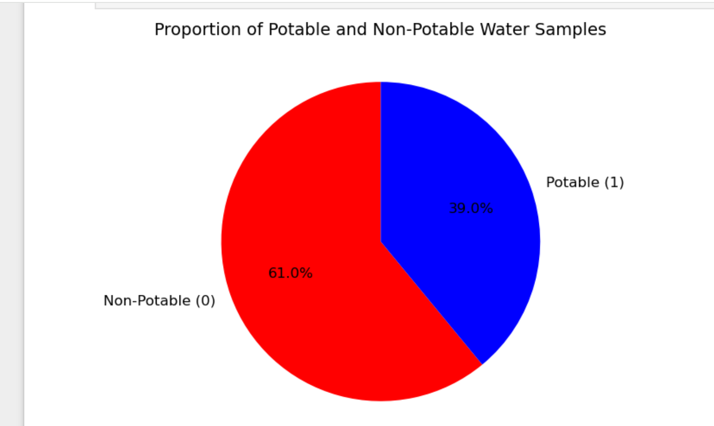
Class Distribution
Understanding Class Distribution:
This slide focuses on the distribution of the target variable, Potability, which indicates whether the water samples are potable (safe for drinking) or non-potable (unsafe for drinking).
Understanding the distribution of classes is crucial for evaluating the balance of the dataset, which can impact model performance.
Class Counts:
The dataset contains two classes:
Potable (1): Represents safe drinking water.
Non-Potable (0): Represents unsafe drinking water.
Present the counts of each class to illustrate the balance or imbalance in the dataset.
Visual Representation:
A pie chart or bar graph can be used to visually represent the proportion of potable and non-potable samples, making it easier to understand the class distribution at a glance.

Slide 17
Model Evaluation
Purpose of Model Evaluation:
This slide discusses the importance of evaluating the performance of the predictive model used to determine water potability.
It highlights how model evaluation helps in understanding the accuracy and reliability of predictions.
Evaluation Metrics:
Key metrics such as accuracy, precision, recall, and F1-score are introduced to assess model performance.
Each metric provides insights into different aspects of the model's effectiveness, particularly in handling imbalanced classes.
Confusion Matrix:
A confusion matrix is presented to visualize the model's performance, showing true positives, true negatives, false positives, and false negatives.
This helps in understanding where the model is making correct predictions and where it is failing.

Slide 18
KNN Implementation
Overview of KNN:
The K-Nearest Neighbors (KNN) algorithm is a simple, yet effective, classification technique that classifies data points based on the classes of their nearest neighbors in the feature space.
It is a non-parametric method, meaning it makes no assumptions about the underlying data distribution.
Hyperparameters:
Key hyperparameters for KNN include:
k: The number of nearest neighbors to consider (default is often 5).
p: The power parameter for the Minkowski distance metric (p=2 for Euclidean distance).
metric: The distance metric used (default is Minkowski).
These hyperparameters can significantly affect the model's performance and need to be tuned for optimal results.
Model Training and Evaluation:
The KNN model is trained using the training dataset, and predictions are made on the test dataset.
Evaluation metrics such as accuracy, confusion matrix, and classification report are presented to assess the model's performance.

Slide 19
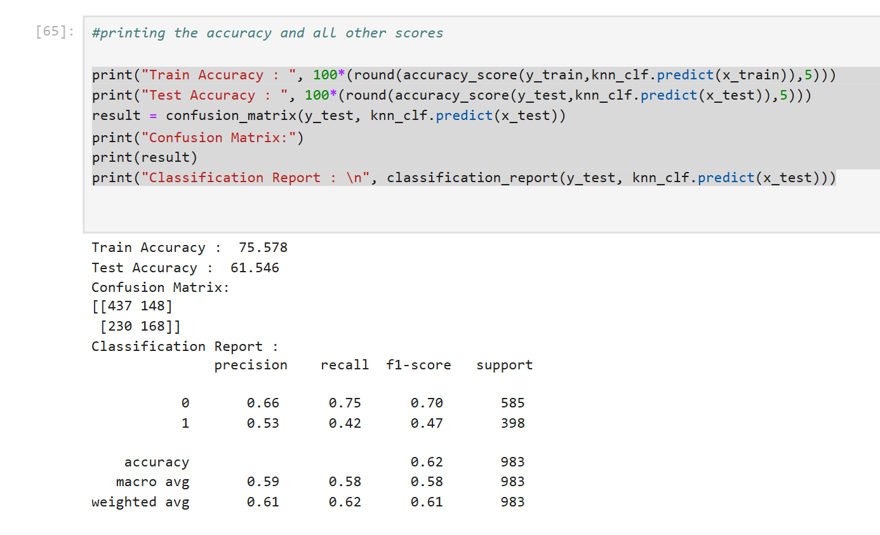

Slide 20
Decision Tree Implementation
Overview of Decision Trees:
Decision Trees are a popular and intuitive classification method that splits the data into subsets based on feature values, creating a tree-like model of decisions.
Each internal node represents a feature, each branch represents a decision rule, and each leaf node represents an outcome (class label).
Hyperparameters:
Key hyperparameters for Decision Trees include:
Criterion: The function used to measure the quality of a split (e.g., "gini" for Gini impurity or "entropy" for information gain).
Max Depth: The maximum depth of the tree, which helps prevent overfitting by limiting how deep the tree can grow.
Splitter: The strategy used to choose the split at each node (e.g., "best" or "random").
Tuning these hyperparameters is crucial for optimizing model performance.
Model Training and Evaluation:
The Decision Tree model is trained on the training dataset, and predictions are made on the test dataset.
Evaluation metrics such as accuracy, confusion matrix, and classification report are presented to assess the model's performance.

Slide 21
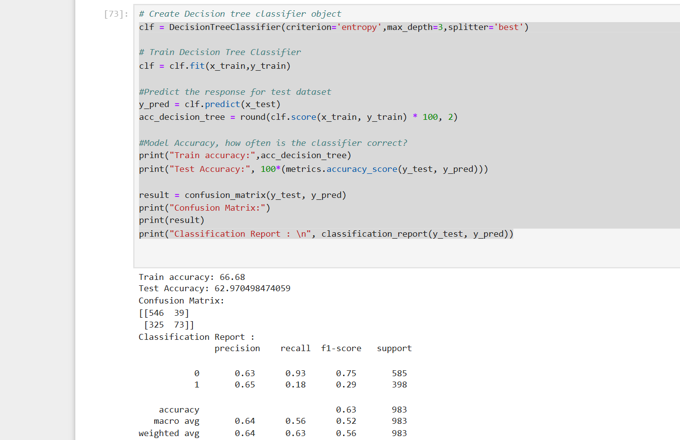

Slide 22
Random Forest Implementation
Overview of Random Forest:
Random Forest is an ensemble learning method that combines multiple decision trees to improve classification accuracy and control overfitting.
It works by creating a "forest" of decision trees, where each tree is trained on a random subset of the data and features, and the final prediction is made by averaging the predictions of all trees (for regression) or by majority voting (for classification).
Hyperparameters:
Key hyperparameters for Random Forest include:
n_estimators: The number of trees in the forest. More trees can improve performance but also increase computation time.
Criterion: The function used to measure the quality of a split (e.g., "gini" or "entropy").
Max Depth: The maximum depth of each tree, which helps prevent overfitting.
Tuning these hyperparameters is essential for optimizing the model's performance.
Model Training and Evaluation:
The Random Forest model is trained on the training dataset, and predictions are made on the test dataset.
Evaluation metrics such as accuracy, confusion matrix, and classification report are presented to assess the model's performance.

Slide 23
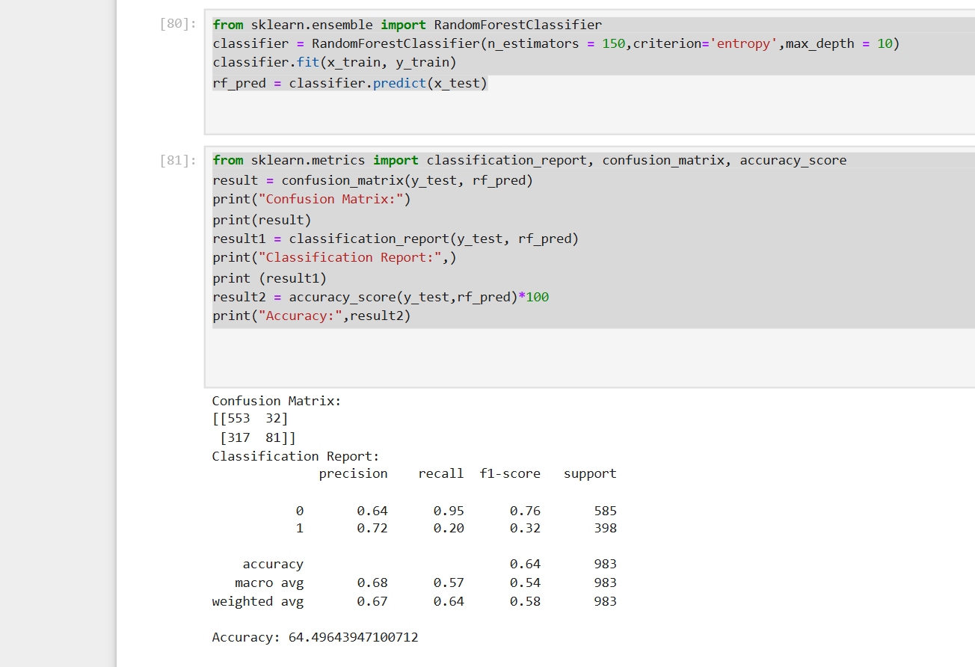

Slide 24
XGBoost Implementation
Overview of XGBoost:
XGBoost (Extreme Gradient Boosting) is a powerful and efficient implementation of gradient boosting that is widely used for classification and regression tasks.
It builds an ensemble of decision trees in a sequential manner, where each new tree corrects the errors made by the previous trees, leading to improved accuracy.
Hyperparameters:
Key hyperparameters for XGBoost include:
learning_rate: Controls the contribution of each tree to the final prediction. A lower learning rate requires more trees but can lead to better performance.
max_depth: The maximum depth of each tree, which helps prevent overfitting.
n_estimators: The number of trees to be built. More trees can improve performance but also increase computation time.
scale_pos_weight: Useful for handling imbalanced datasets by adjusting the weight of positive classes.
Proper tuning of these hyperparameters is crucial for optimizing model performance.
Model Training and Evaluation:
The XGBoost model is trained on the training dataset, and predictions are made on the test dataset.
Evaluation metrics such as accuracy, confusion matrix, and classification report are presented to assess the model's performance.

Slide 25
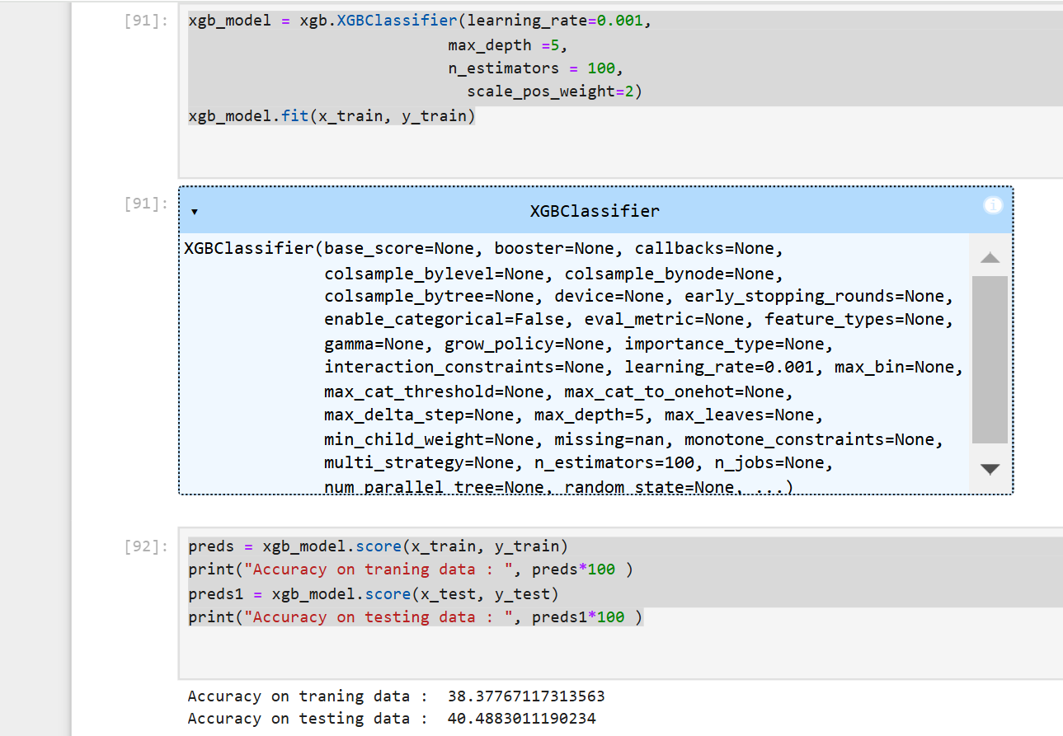

Slide 26
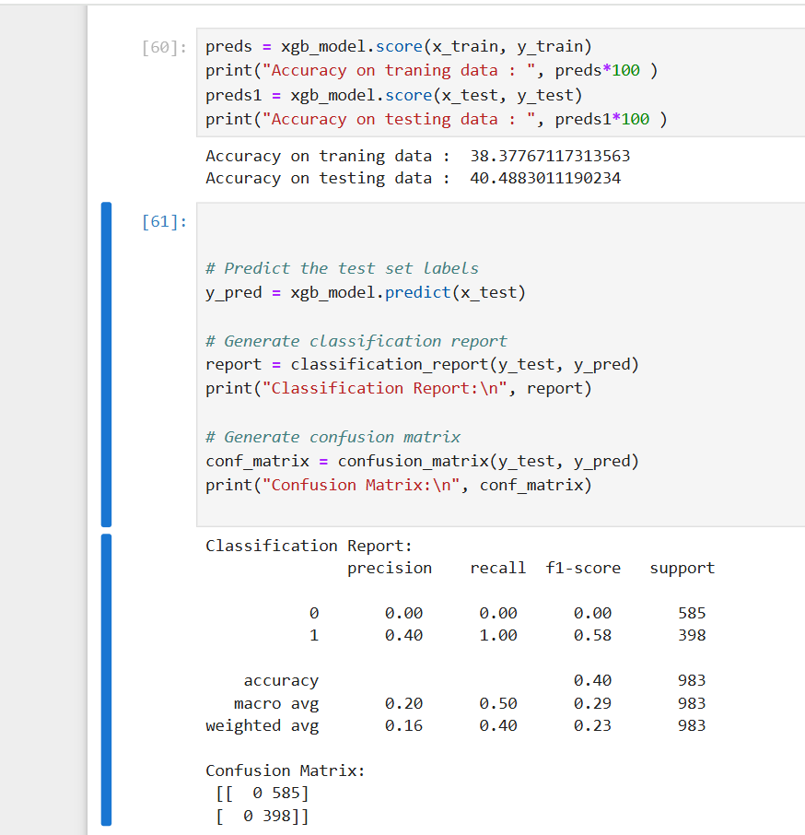

Slide 27
SVM Implementation
Overview of Support Vector Machine (SVM):
Support Vector Machine (SVM) is a powerful supervised learning algorithm used for classification and regression tasks. It works by finding the optimal hyperplane that separates different classes in the feature space.
SVM is particularly effective in high-dimensional spaces and is robust against overfitting, especially in cases where the number of dimensions exceeds the number of samples.
Kernel Trick:
SVM can use different kernel functions (e.g., linear, polynomial, radial basis function (RBF)) to transform the input data into a higher-dimensional space, allowing it to find non-linear decision boundaries.
The choice of kernel is crucial for the model's performance, especially when dealing with complex datasets.
Model Training and Evaluation:
The SVM model is trained on the training dataset, and predictions are made on the test dataset.
Evaluation metrics such as accuracy, confusion matrix, and classification report are presented to assess the model's performance.

Slide 28
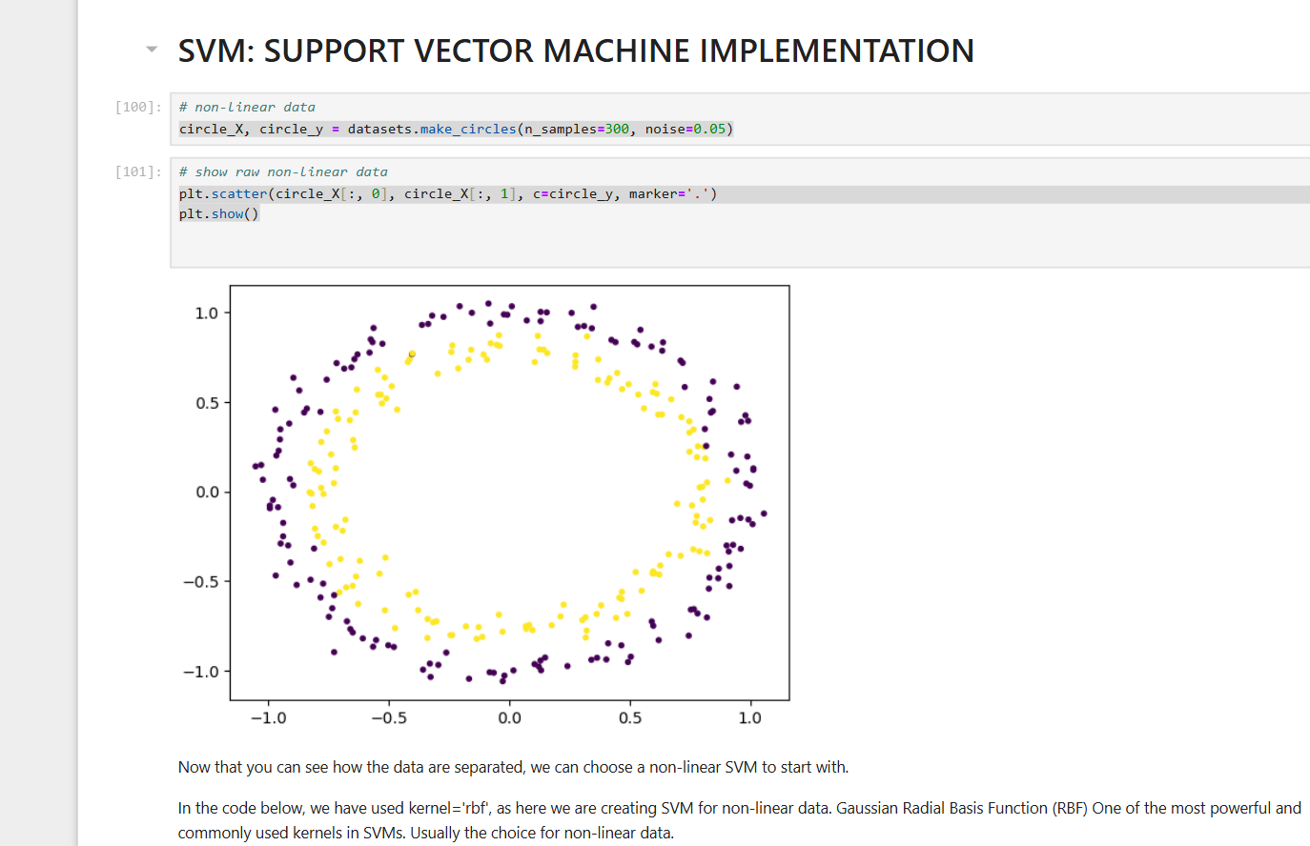

Slide 29
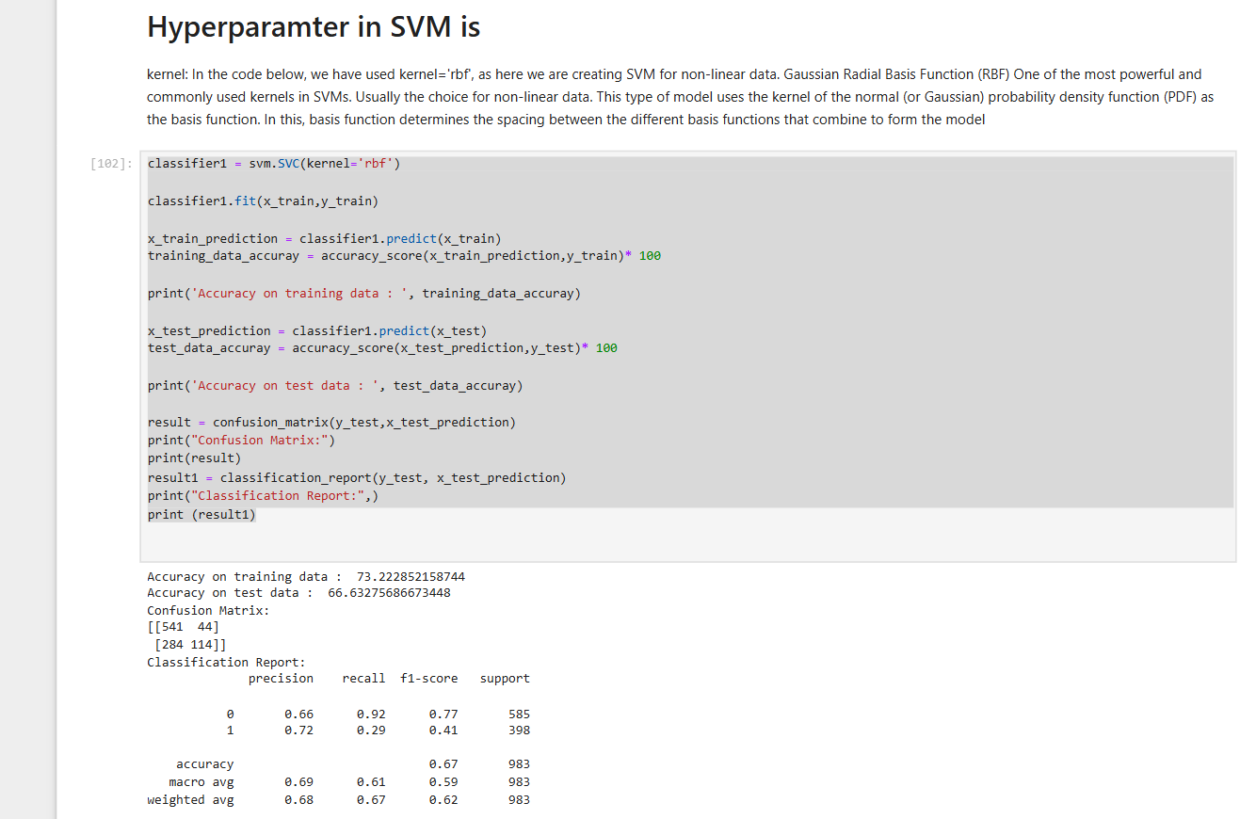

Slide 30
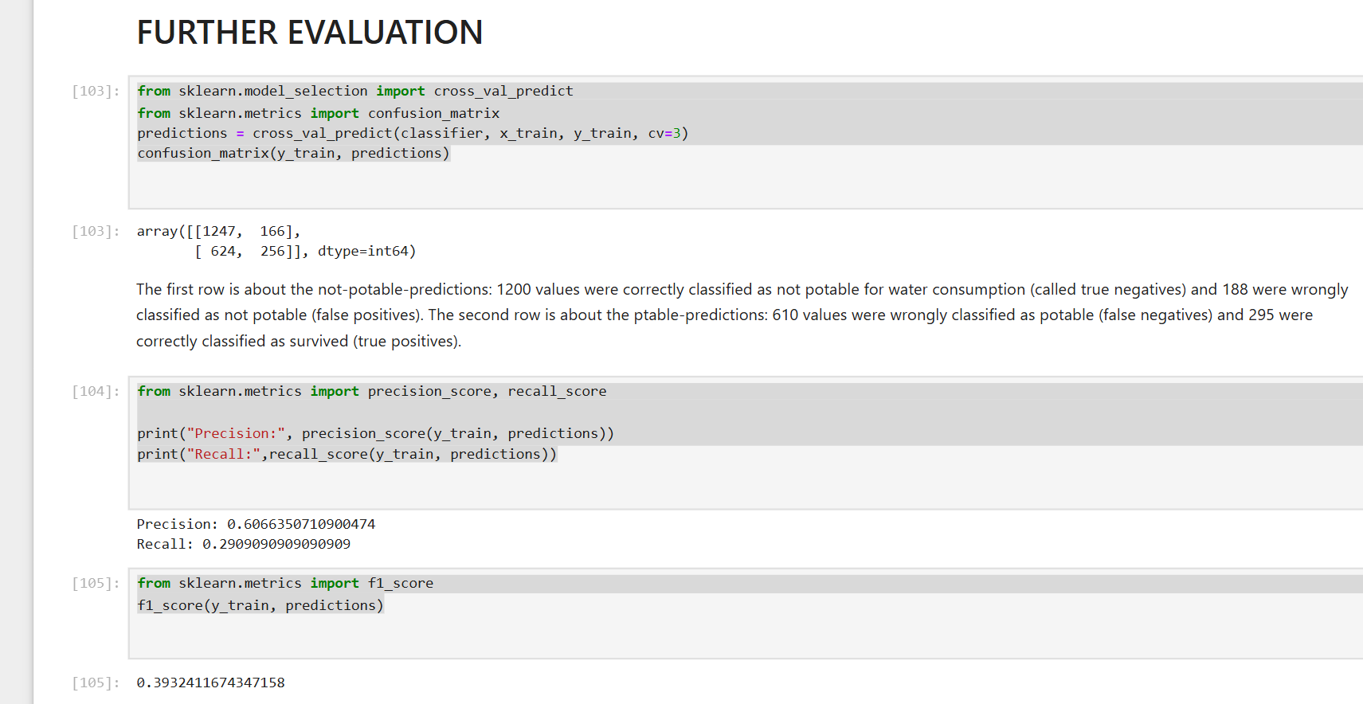
Further Evaluation

Slide 31
RESULT¶
From the results obtained, Support Vector Machine is a preferable method. It did not suffer the condition of overfitting and performed well when there is a clear indication of separation between classes. SVM Classifier in comparison to other classifiers have better computational complexity and even if the number of positive and negative examples are not same, SVM has the ability to normalize the data or to project into the space of the decision boundary separating the two classes. Other reason to say that SVM is better than other algorithms is the reason that it can also perform in n-Dimensional space. Random Forest performed well, however it shows overfitting, hence it isn’t preferred.

Slide 32
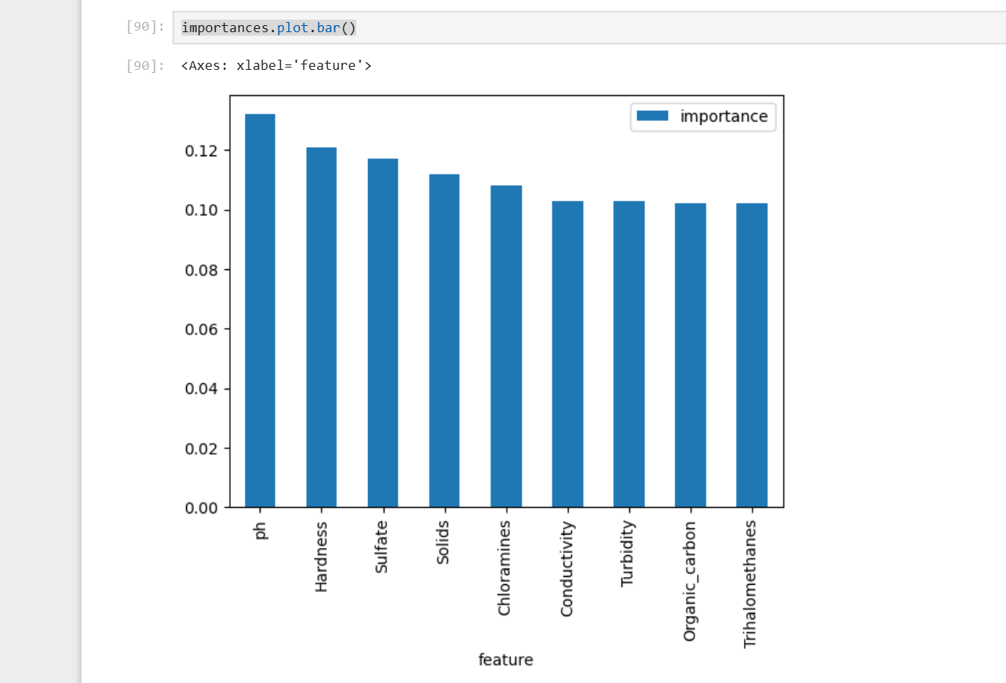
Conclusion
After experimenting and trying out different algorithms the conclusion drawn was that “pH” is the attribute which majorly affects the quality of water samples.

Slide 33
Thank You!

